Slide 1
CHAPTER 12
GUI BASICS

Slide 2
What is “Graphic User Interface”?
UI: Front end of your software that interacts with an user
GUI: Non-text based UI, use of graphic elements to allow users intuitive interactions with your software
  The acronym GUI is commonly used, and pronounced as “gooey”

Slide 3
AWT (Abstract Window Toolkit)
& Swing
What are they?
  They are GUI libraries
What packages are they in?
  java.awt package
  javax.swing package (‘x’ stands for extension, they are not core Java, but it is in standard JRE downloads)
What is the difference?
  awt components are heavyweights (depends on native libraries to paint on canvas)
  swing replaces heavyweight components with lightweight components

Slide 4
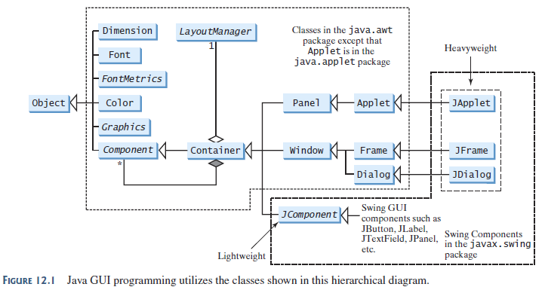
Get to know this hierarchy well

Slide 5
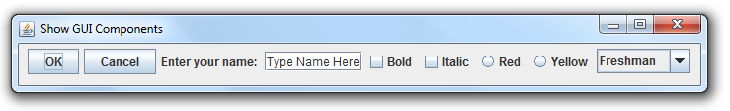
Steps to create figure 8.1
3 main steps
1. Create GUI components
2. Use a panel to group them together
3. add the panel into a window

Slide 6
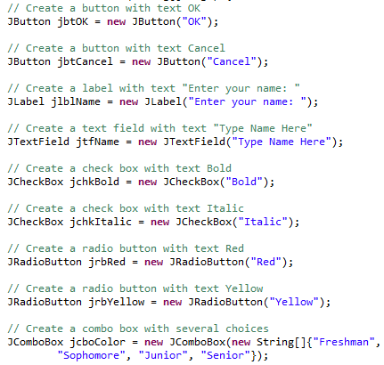
Step 1
Instantiate and initialize all GUI components

Slide 7
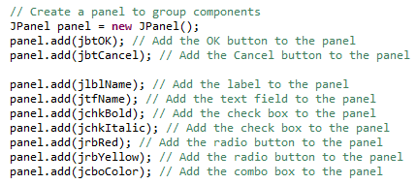
Step 2
Group them into a “panel” container object

Slide 8
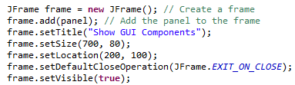
Step 3
Create a window frame and add the panel into it

Slide 9
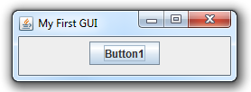
Exercise 1
The previous GUI uses Swing components
  JButton, for example, as opposed to Button
Following the 3 steps on the previous slides, display a button in a window:

Slide 10
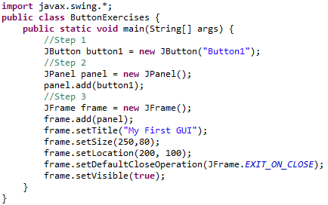
Exercise 1 (Answers)

Slide 11

Exercise 2
Add more buttons and create this GUI:

Slide 12
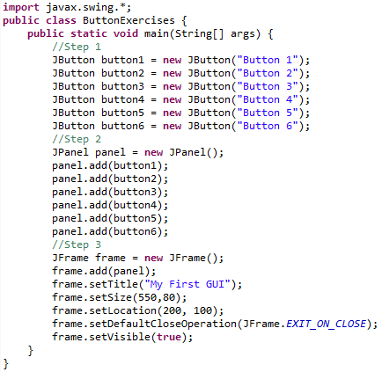
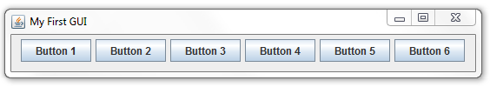
Exercise 2 (Answers)

Slide 13
Exercise 3: Know your GUI components
Recreate this GUI (try to recall without looking back on previous slides) will refresh your memory on a few more components:
  JButton - JRadioButton
  JLabel - JComboBox (string array
  argument needed)
  JTextField
  JCheckBox

Slide 14
Container classes
We have used two container classes so far
  JPanel
  JFrame
Other container classes:
  Container
  JDialog
  JApplet (Chapter 18)
Every container has a layout manager

Slide 15
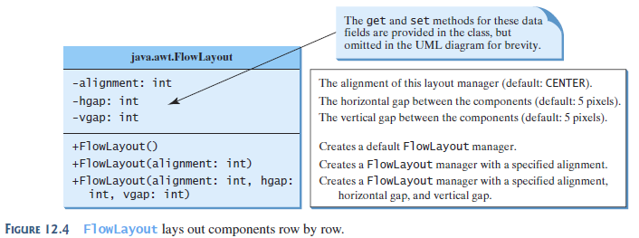
FlowLayout

Slide 16
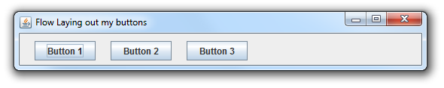
Demo
From our 6-button example earlier, let us make some changes:
  Lay only three buttons, 20 pixels apart and 10 pixel vertical gap
  Directly add buttons into a subclass frame object
  Align them to the left of the frame

Slide 17
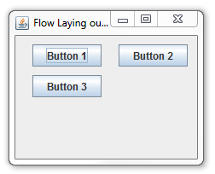
To show vertical gap
The display was resized to show vertical gap ➔

Slide 18
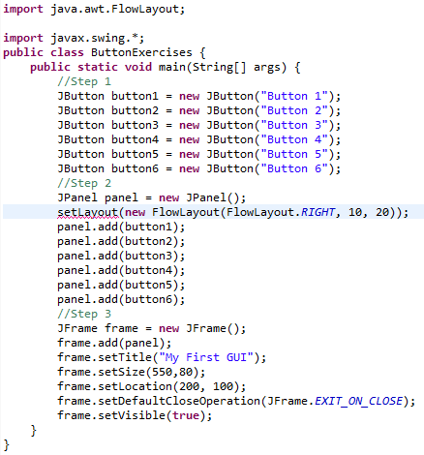
Why can’t we do this?

Slide 19
Answers
Note that setLayout has to be in a container, the preceding code segment is not in a container!
We could extend JFrame, to create a container class to begin with, then
  Get the constructor to specify layout
  Add buttons to it directly

Slide 20
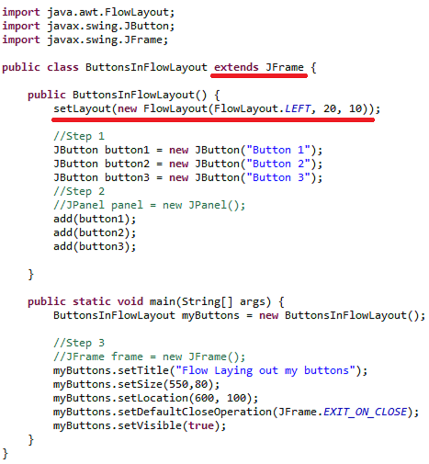
Answers (cont.)

Slide 21
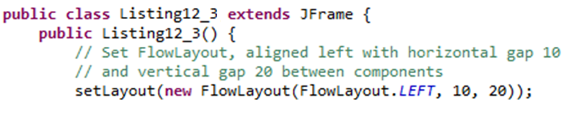
Another example of
FlowLayout
The subclass of JFrame below uses the setLayout method to define a layout manager for the class

Slide 22
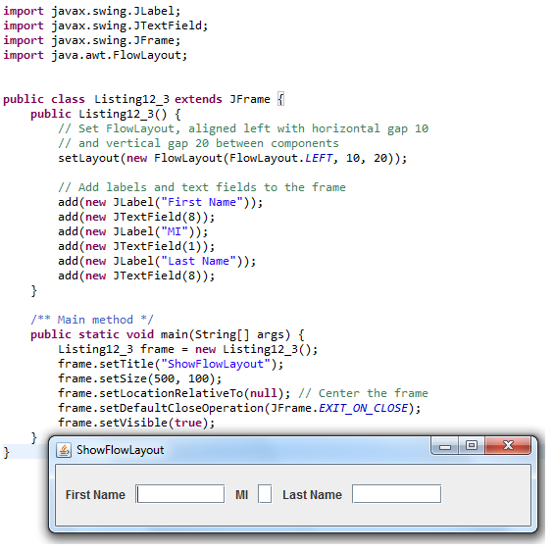
The full program

Slide 23
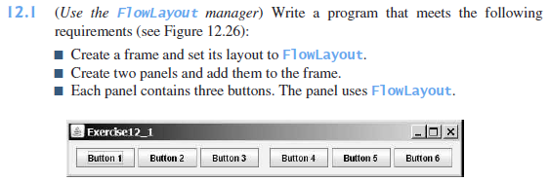
Exercise 4

Slide 24
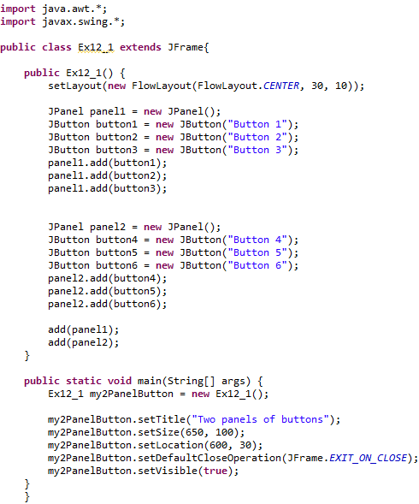
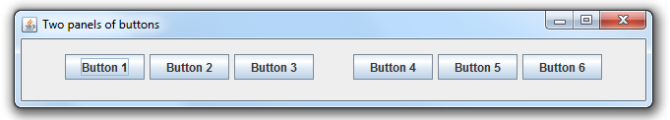

Slide 25
Extending JFrame
Using one style consistently makes programs easy to read.
From now on, most of the GUI main classes will extend the JFrame class.
The constructor of the main class constructs the user interface.
The main method creates an instance of the main class and then displays the frame.

Slide 26
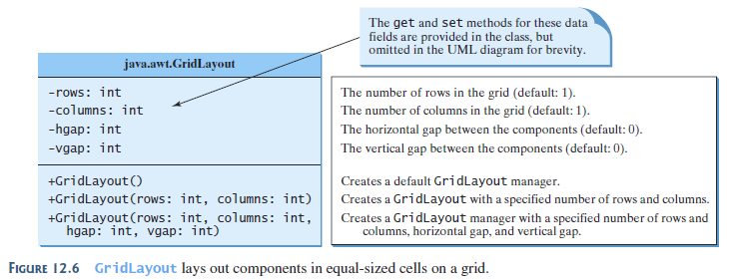
GridLayout
If the rows parameter is nonzero. The actual number of columns is calculated by the layout manager

Slide 27
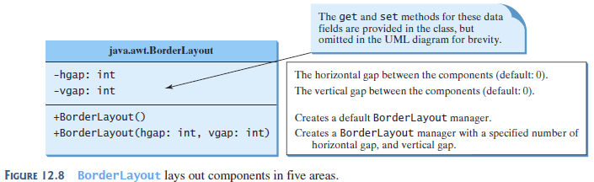
BorderLayout

Slide 28
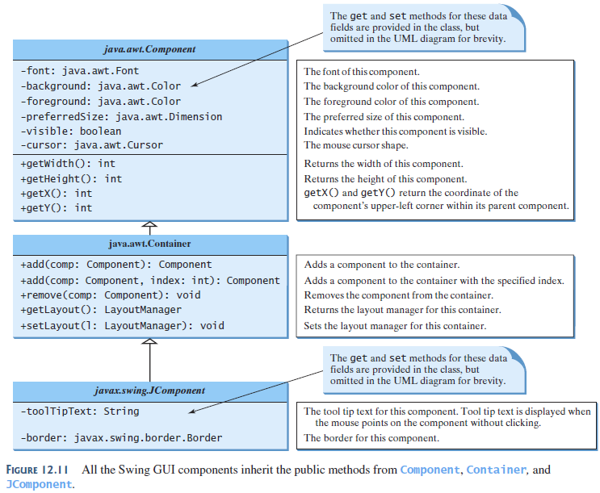

Slide 29
Helper Classes
We will do more with these classes next but actually they are intuitive to use:
  The Color Class
  The Font Class

Slide 30
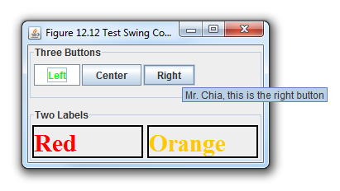
Figure 12.12
This is a fun one, try build this

Slide 31
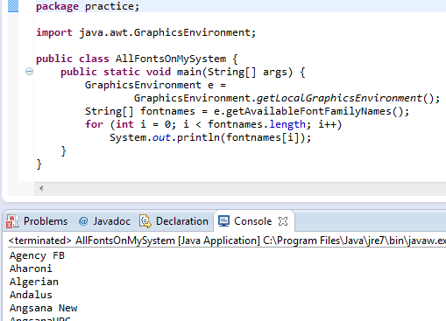
What fonts are available to me?

Slide 32
And…
…more to come!

